Slide 1
From “Cash on the internet” to “Digital Gold”
Claire Ingram Bogusz

Slide 2
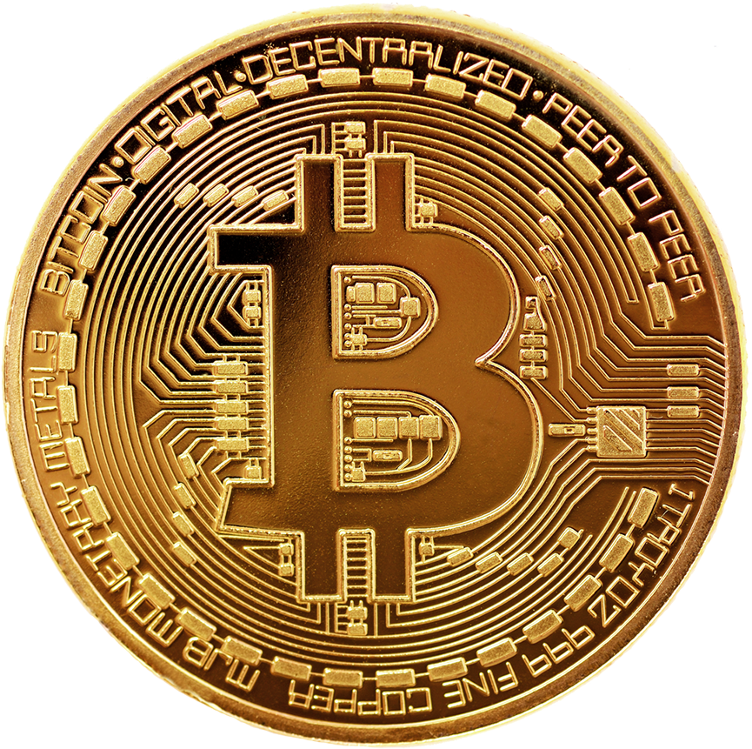
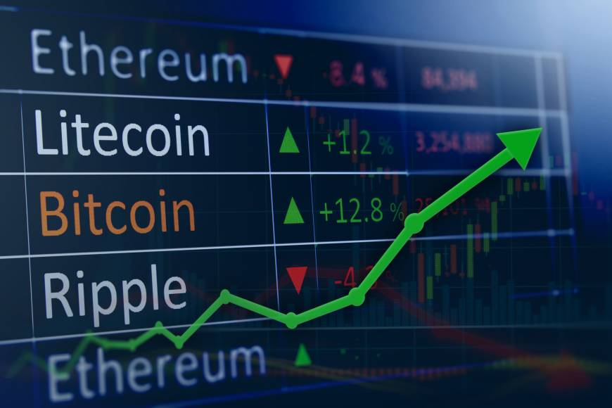
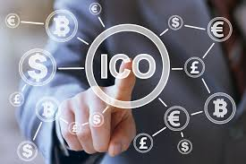
Notes:
How many of you own Bitcoin? Other Cryptocurrencies? Invested in an ICO?

Slide 3
TODAY
Background to Cryptocurrencies ( ”Bitcoin”) & Distributed Ledgers (”Blockchain”)
Actors & Motivations
Development & Code “Forking”
Strengths & Weaknesses
Applications & Societal Effects
Further Reading

Slide 4
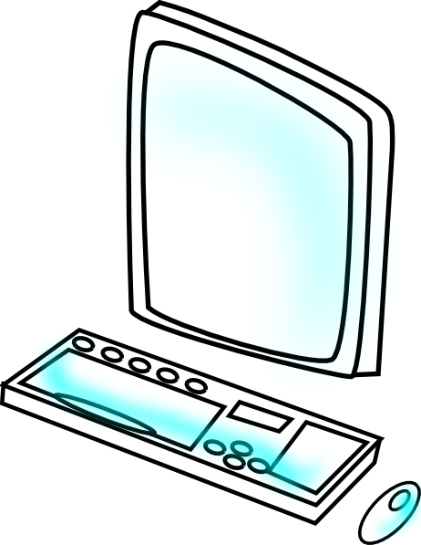
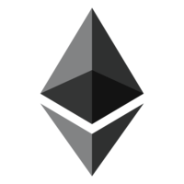
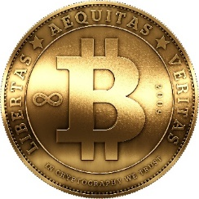
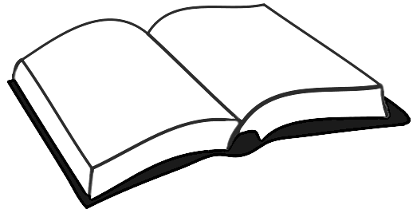
19UJAQMPqxDqhkppwzd1YFtfTbLiX3rjJ9
“Currency” (e.g. Bitcoin / Ether)
Tokens
Cryptography
Asset agnostic
Market-based value
Varying degrees of pseudononymity
“Infrastructure” (e.g. Blockchain / Ethereum)
Ledger and Process
Verification at scale
Distributed
Record that is hard to change/destroy
Notes:
An electronic payment system based on cryptographic proof instead of trust,
Allowing any two willing parties to transact directly with each other without the need for a trusted third party,
Transactions that are computationally impractical to reverse would protect sellers from fraud,
Routine escrow mechanisms could easily be implemented to protect buyers,
Peer-to-peer distributed timestamp server to generate computational proof of the order of transactions,
Secure as long as honest nodes collectively control more CPU power than any cooperating group of attacker nodes.

Slide 5


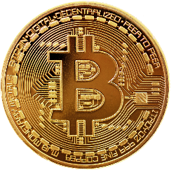
A DISTRIBUTED LEDGER
Clip art image by Cliparts.co
19UJAQMPqxDqhkppwzd1YFtfTbLiX3rjJ9

Slide 6
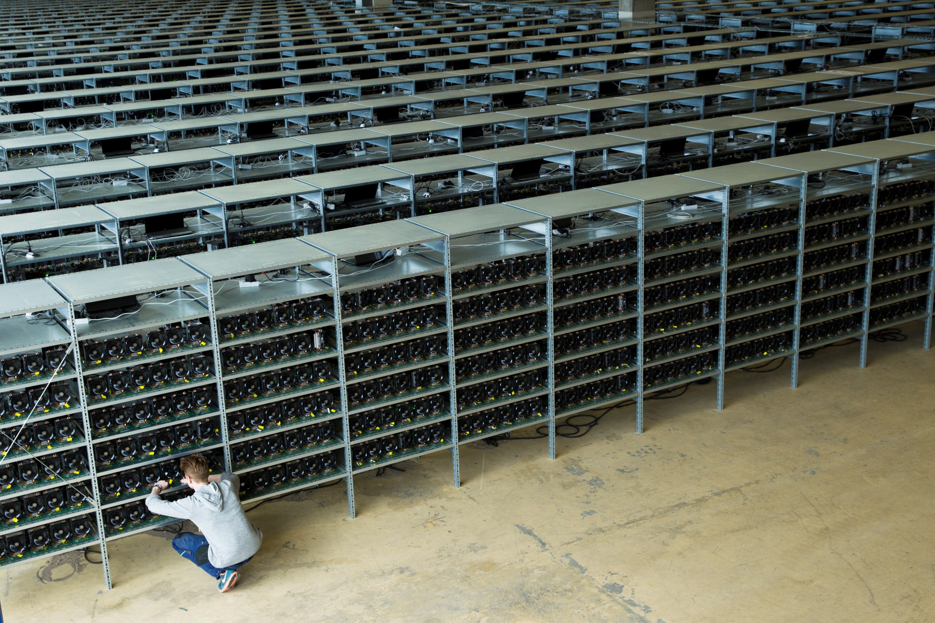
KnCMiner, 2015
Notes:
Requires massive servers and computer power to maintain—hard work done by machines, not humans. This could be any server room in the world—but is larger. Is KNC miner’s bitcoin mining farm in Norrland. Move into discussion of Bitcoin and Blockchain.

Slide 7
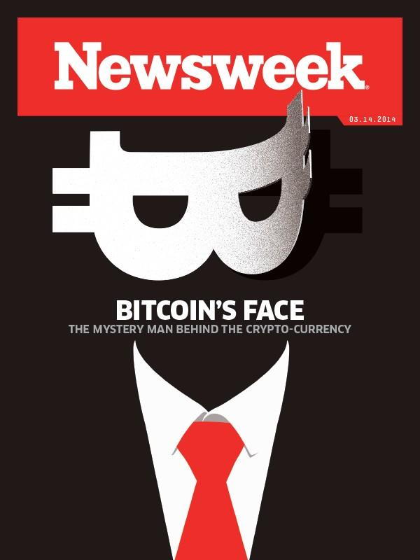
Bitcoin Protocol released in 2008 by “Satoshi Nakamoto” in a paper on The Cryptography Mailing list
Underlying Open Source technology called “the Blockchain”
Released the first version of the bitcoin software client in 2009
Disappeared in 2010
Infrastructure maintained by community
Has since “forked” into new infrastructures innumerable times
Notes:
Weakness of the trust based model:
Non-reversible transactions are not really possible,
The cost of mediation increases transaction costs,
Small, casual transactions consequently expensive,
With the possibility of reversal, the need for trust spreads.
Fraud is accepted as unavoidable.
These costs and payment uncertainties can be avoided in person by using physical currency, but no mechanism exists to make payments using IT without a trusted party.

Slide 8
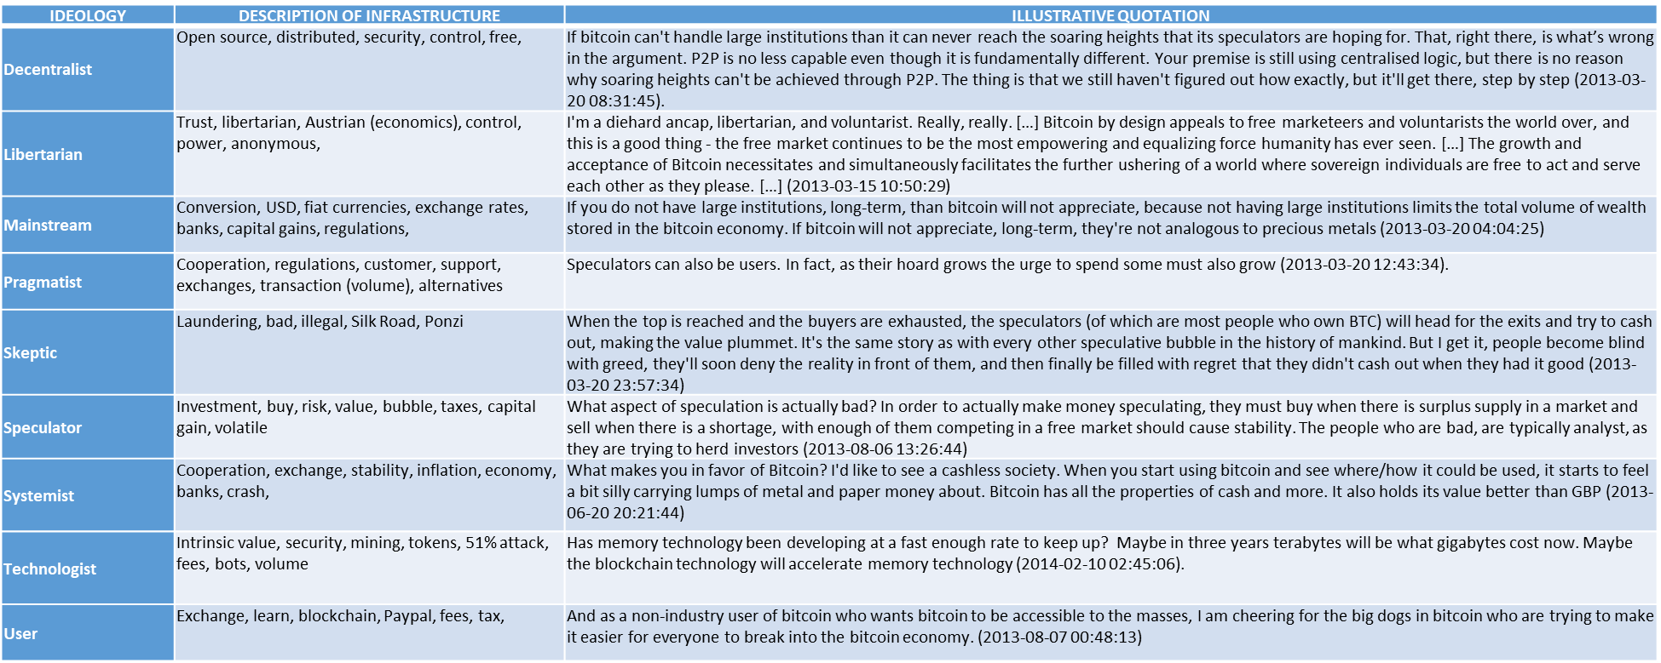
DIFFERENT GROUPS WITHIN COMMUNITY
Ideology | Description of infrastructure
Decentralist | Open source, distributed, security, control, free,
Libertarian | Trust, libertarian, Austrian (economics), control, power, anonymous,
Mainstream | Conversion, USD, fiat currencies, exchange rates, banks, capital gains, regulations,
Pragmatist | Cooperation, regulations, customer, support, exchanges, transaction (volume), alternatives
Skeptic | Laundering, bad, illegal, Silk Road, Ponzi
Speculator | Investment, buy, risk, value, bubble, taxes, capital gain, volatile
Systemist | Cooperation, exchange, stability, inflation, economy, banks, crash,
Technologist | Intrinsic value, security, mining, tokens, 51% attack, fees, bots, volume
User | Exchange, learn, blockchain, Paypal, fees, tax,
Decentralist
Libertarian
Mainstream
Pragmatist
Skeptic
Speculator
Systemist
Technologist
User
Decentralist
Mainstream
Libertarian
Pragmatist
Skeptic
Speculator
Technologist
Systemist
User

Slide 9
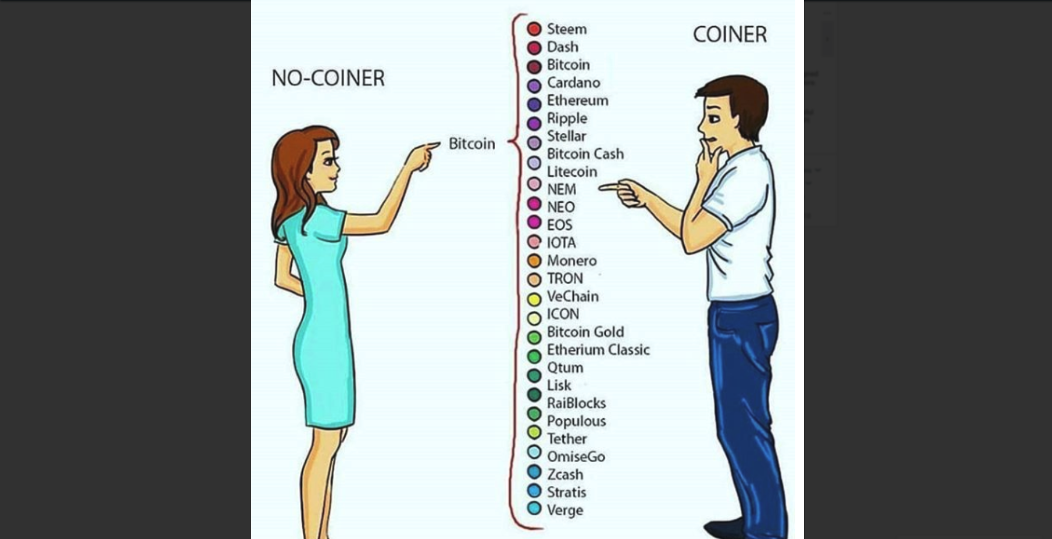

Slide 10
STRENGTHS & WEAKNESSES

Slide 11
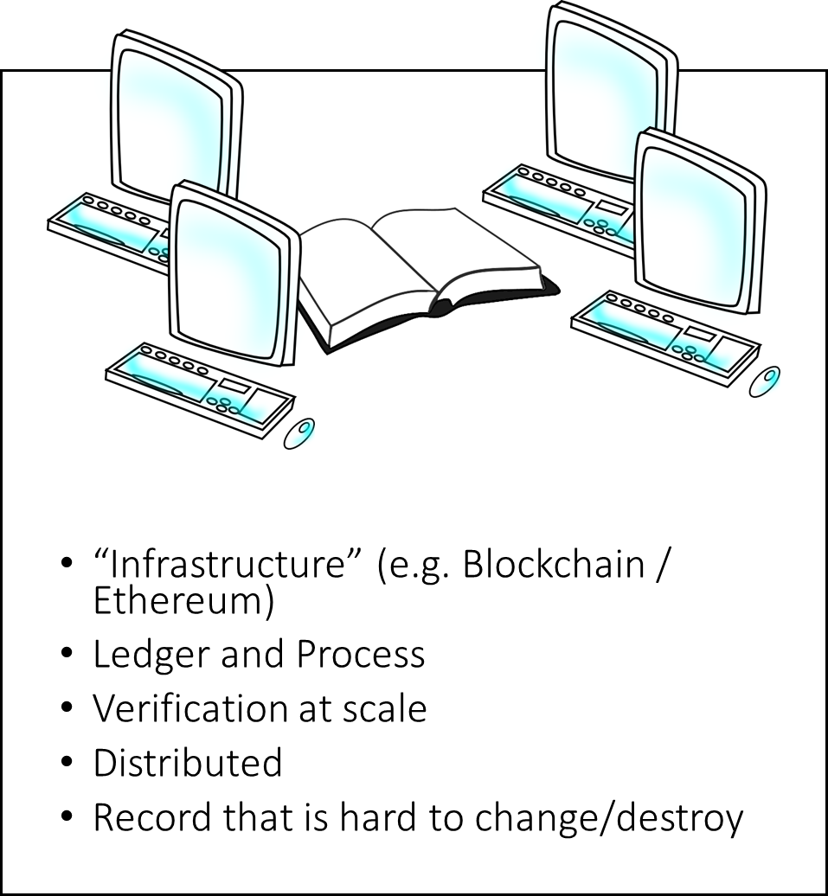
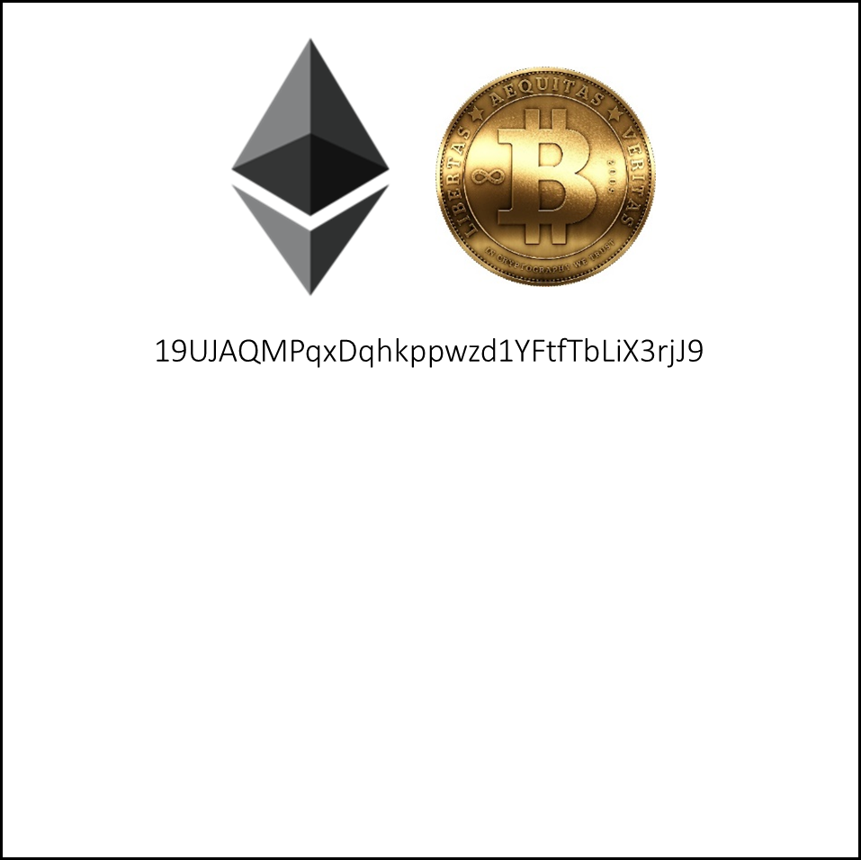
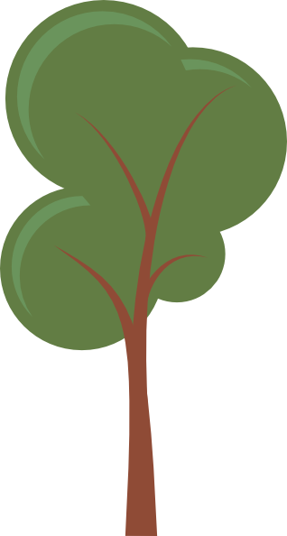
“Currency” (e.g. Bitcoin / Ether)
Tokens
Cryptography
Asset agnostic
Market-based value
Varying degrees of pseudononymity
Notes:
An electronic payment system based on cryptographic proof instead of trust,
Allowing any two willing parties to transact directly with each other without the need for a trusted third party,
Transactions that are computationally impractical to reverse would protect sellers from fraud,
Routine escrow mechanisms could easily be implemented to protect buyers,
Peer-to-peer distributed timestamp server to generate computational proof of the order of transactions,
Secure as long as honest nodes collectively control more CPU power than any cooperating group of attacker nodes.

Slide 12
APPLICATIONS

Slide 13
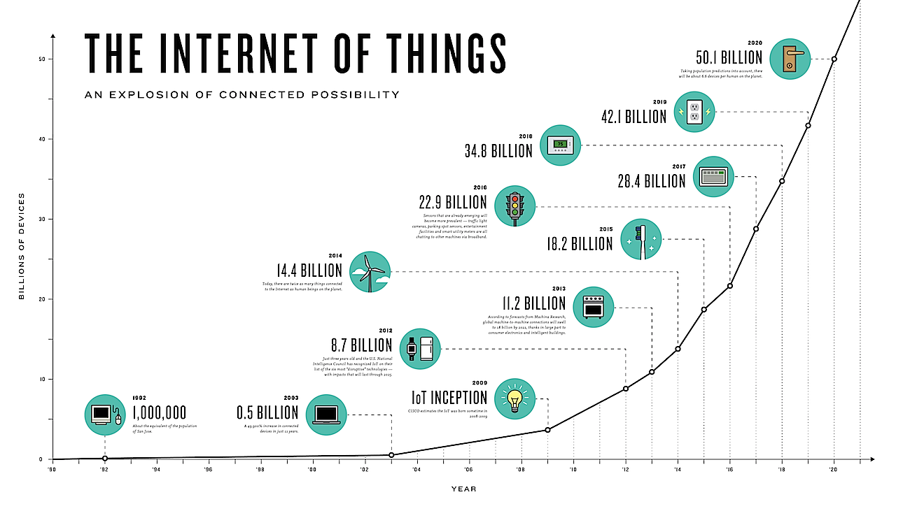
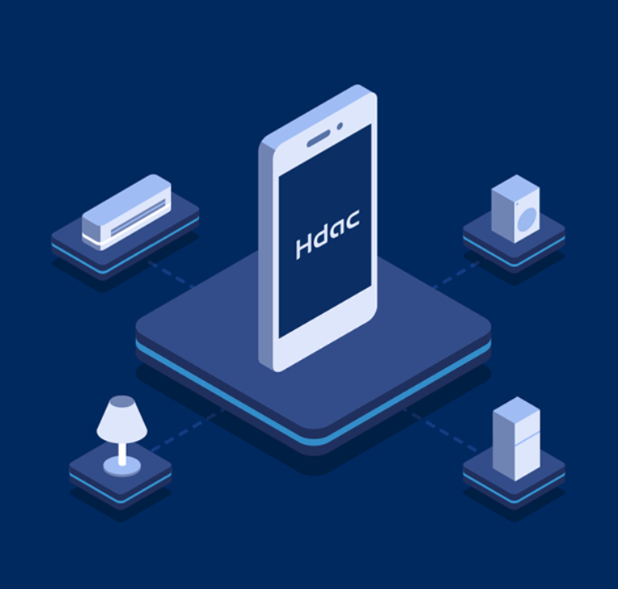
Graphic from: http://www.i-scoop.eu/internet-of-things/
Notes:
And what if we connect all of our devices, such that they automate and share themselves? Rich future, lots of possibilities, requires that we stay alert and aware. Also will require continuous learning and re-skilling as skills needed change in line with technology.

Slide 14

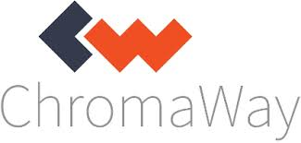

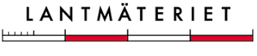
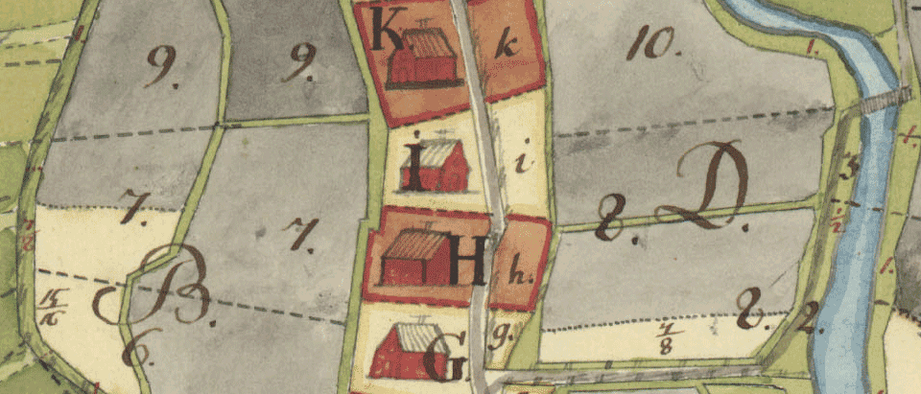
Image from Läntmateriet

Slide 15
FURTHER READING
Swedish
The Swedish e-Krona project
Report on Lantmäteriet’s land registry project
International
Chapter on Blockchain and standardisation (disclaimer: co-author)
CB Insights’ report on Blockchain investments
Ethereum Dapps marketplace
Hdac example

Slide 16
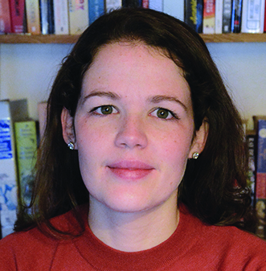




Claire Ingram Bogusz
Stockholm School of Economics
claire@clairebogusz.com
@Claire_EBI
slides.clairebogusz.com

