Slide 1
The E-krona project in a nutshell . Institutet för framtidsstudier Stockholm (2018-03-06)
Björn Segendorf Senior Adviser

Slide 2
Cash: The product of central banks
Cash in circulation outside the bank sector
Innovation
Growth
Maturity
Market penetration
Time

Slide 3
A pro-active stance
An eventual launch of a CBDC takes time
Designed to meet shortcoming of the future retail payments market
What do we believe about the future market (10 years, if nothing is done?)
Single points of failure and/or no Swedish payment infrastructure
Non-banks have limited access to infrastructure (partly b/c the Finality Directive)
Some groups experience problems from reduced access to cash services
Limited access to central-bank money for the general public

Slide 4
What can a CBDC do?
It will function as money: means of payment. unit of account, store of value
Guarantee access to central-bank money
Perhaps even more important: it is an infrastructure!
Reduce single-point of failure issues and ensure a Swedish infrastructure
Increase non-bank access to settlement services in central bank money
Function as a platform for innovation
Facilitate payments for vulnerable groups?

Slide 5
The role of the Riksbank
Payment processing
Payment Service Providers
Users
Processors
Central bank
Payer
Authorization:
Verification, identification
Available means, AML/CTF, …
Issuing
withdrawal
settlement
Interface: communication channel, initiation…
Payee
Post-transaction:
confirmation, payment information, …

Slide 6
A high-level concept
Claim on the central bank (RB has to ”own” the accounts…)
Available for both consumers, businesses, associations and authorities
Low value payments 24/7; P2P, P2B, P2G, …
Account/register based
Possibly complemented by a value based add-on
Possibly a function for off-line functionality
Not interest rate bearing
Possibly quantitative restrictions to limit size and control RB & banks’ balance sheets
Bought through transfers in RTGS but also another channel for non-RIX members
May allow for partly anonymous payments (payer unknown to payee but central operator have all information)

Slide 7
Impact of a retail CBDC
Gradual establishment on the retail payments market
No single ”killer” property
Incumbent advantage of existing payment services
Limited effect on the banks’ business models
Limited/small effect on balance sheets of central bank and banking sector
Limited/small effect on monetary policy

Slide 8
What happens now?
2017: First analysis & project report
2018
deeper analysis of policy issues, legal issues, governance
Dialogue with technology providers.
Initiating work on proof of concept?
End of year: Decision to continue or not
2019 (earliest) - : Proof of concept, pilot,…?
2020…

Slide 9
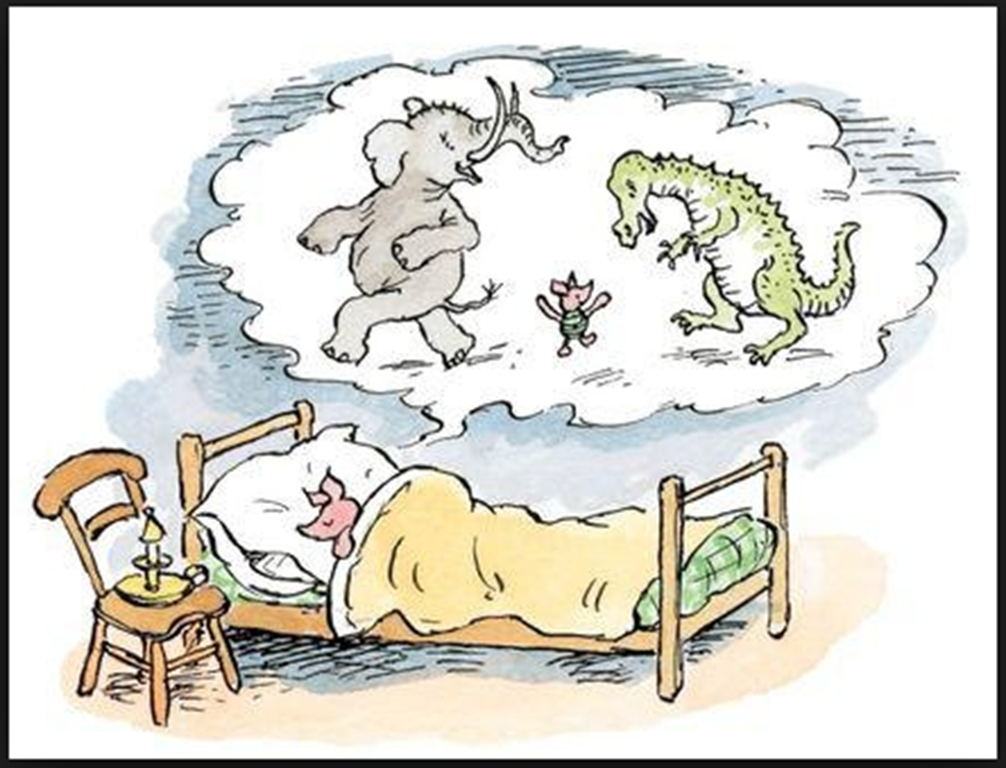
http://www.riksbank.se/en/Financial-stability/Payments/Does-Sweden-need-the-e-krona/

Slide 10
EXTRA

Slide 11
The Riksbank’s biannual household payment survey
Q. Which of the following payment methods have you privately used in the past month?
Cash 2010: 94% 2016: 79%
Q: How did you pay the last time you paid for something?
Cash 2010: 39% 2016: 15%
Q: What was your main payment method for payments below SEK 100 (EUR 10) over the past month?
Cash 2010: 59% 2016: 26%
Q: Would you be able to cope without cash in society as it is at present?
Yes: 63% (2016)
http://www.riksbank.se/en/Statistics/Payment-statistics/
Notes:
What do we then know about the household’s payment behaviour? The Riksbank has since 2010 done a biannual survey, and let me give you a few glimpses relating to the use of cash.
The last survey was made in September last year.
In the first bullet-point we see that 4 out of five Swedes hasn’t used cash in the past month.
The second bullet tells us that only one in six payments are made in cash. This is a low number in an international comparison
The third bullet says that only one in four pay low amounts, below EUR 10, in cash. Debit card is the dominating way of paying.
According to the last bullet, 2 out of 3 say that they can cope without cash. I can also say that two thirds of the population view the decreasing use of cash as positive or doesn’t have an opinion on it.
So, summing this up, we can see that cash has been loosing a lot of ground over the last couple of years. Here is a link where you can find more information.

Slide 12
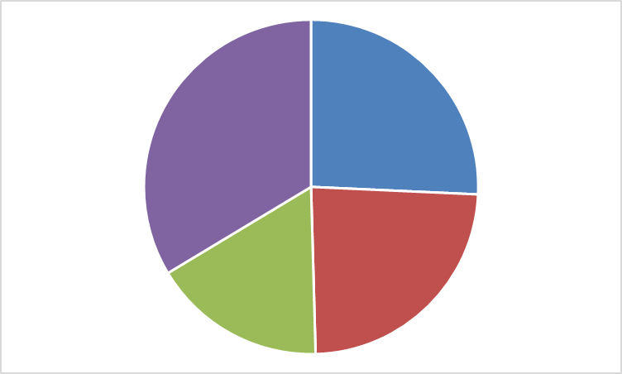
What about the future?
Point-of-sale payment services is a two-sided market
The logic works both ways
Now it is households that are abandoning cash
Ongoing research project: at what point may merchants stop taking cash?
Niklas Arvidsson, Royal Institute of Technology (KTH)
Jonas Hedman, Copenhagen School of Business
Björn Segendorf, Riksbank
Survey data from a broad range of merchants
When do you think that you will stop accepting cash?
>2030
2020
2025
2030
50%
Notes:
It is well established that the market for payment services, and especially for payment services used at the POS, is a two-sided market. Merchants only want to take cards if enough consumers have and use cards. Consumers only want to have and use cards if enought merchants accept them. You simply need to have both sides of the market on board to be able to successfully introduce a payment service.
But, less discussed is that the logic behind two-sided markets goes in both directions. If a payment service is used by less and less consumers, that side of the market will loose mass and at some point it may loose its critical mass. Merchants will then stop taking accepting this payment service and it may vanish very quick.
For Sweden, one may wonder is households’ use of cash is starting to reach such a critical point. Niklas Arvidsson and Jonas Hedman, two payment-interested researchers, and I are currently conducting a study on exactly that question. It is a study based on survey answers from a broad range of merchants. We got the data in May and are still working on it, but let me share one finding.
Among other things, we asked at what year the merchants believed that they would stop taking cash. (Pie-diagram). Roughly one quarter said 2020, at the latest and nearly half of merchants said 2025 at the latest. I think this indicates that cash in a couple of years time may find itself in a situation where declining usage and declining acceptance are feeding each other in a negative spiral.

